Slide 1


The 38th ACM/SIGAPP Symposium on Applied Computing (SAC 2023)
MCRepair: Multi-Chunk Program Repair via Patch Optimization with Buggy Block
Jisung Kim and Byeongjung Lee
{kimjisung78, bjlee}@uos.ac.kr
Software Engineering Laboratory (SELAB)
Dept. of Computer Science and Engineering
University of Seoul, Republic of Korea
Presented by Jisung Kim
Presented at 28th, March, 2023.

Slide 2




Introduction
Automated Program Repair
(APR)
Buggy Program
Fixed Program
< / >
< / >
Fault Localization
A step to identify bugs
Program Repair
A step to repair the identified bugs

Slide 3

Introduction
A bug
Automated Program Repair
(APR)
A fixed bug
Buggy Location
Fixed Location
Patch Space
A source code line
related to a bug
A location that fixes a buggy location
Candidate Patch#1
OR
OR
A source code to fix one or more buggy chunks
Buggy Chunk
Fixed Chunk
Continuous Buggy Location
Continuous Buggy Location
Candidate Patch#2
Continuous Buggy Location
⋯⋯⋯
Continuous Buggy Location
Candidate Patch#N
A set of one or more continuous buggy locations
The space generated by
the candidate patches
A chunk that fixes a buggy chunk

Slide 4
Introduction
Kind of Bugs
Bugs are classified into single-chunk and multi-chunk bugs according to the number of buggy chunks.
Especially, repairing multi-chunk bugs is a challenging problem due to the three complex problems.
A Single-chunk
bug
A Multi-chunk
bug
Buggy Chunk#1
Buggy Chunk#1
Buggy Location#1
Buggy Location#1
Buggy Location#N
Buggy Location#2
⋯⋯⋯
Buggy Chunk#2
Buggy Location#4
⋯⋯⋯
Buggy Chunk#M
Buggy Location#N

Slide 5
Introduction
1st Problem
(Large patch space based on the number of buggy chunks)
When candidate patches are generated per buggy chunk, patch space increases exponentially.
It becomes more time-consuming to find the correct patches in the space.
A multi chunk
bug
Automated Program Repair
(APR)
Large Patch Space
Buggy Chunk#1
Buggy Location#1
Candidate Patches#1
⋯⋯⋯
Buggy Location#2
⋯⋯⋯
Buggy Chunk#2
Buggy Location#4
Candidate Patches#2
⋯⋯⋯
⋯⋯⋯
Buggy Chunk#M
Buggy Location#N
Candidate Patches#N

Slide 6
Introduction
2nd Problem
(Dependencies of buggy chunks)
Each buggy chunk has a dependency that calls each other or shares the same flow.
However, most APR techniques ignore the dependency and generate candidate patches per buggy chunk.
A multi chunk
bug
Automated Program Repair
(APR)
Large Patch Space
Buggy Chunk#1
Candidate Patches#1
Buggy Location#1
⋯⋯⋯
Buggy Location#2
⋯⋯⋯
Buggy Chunk#2
Candidate Patches#2
Buggy Location#4
⋯⋯⋯
⋯⋯⋯
High dependency
=> However, they are not a chunk
Buggy Chunk#M
Buggy Location#N
Candidate Patches#N

Slide 7
Introduction
3rd Problem
(Patch combination)
When a module has a multi-chunk bug, an APR technique must combine candidate patches and repair the module simultaneously.
Nevertheless, the patch space also increases exponentially based on the number of combinations.
A multi chunk
bug
Automated Program Repair
(APR)
More Large Patch Space
Buggy Chunk#1
Combined Patches
Candidate Patches#1
Buggy Location#1
⋯⋯⋯
Buggy Location#2
⋯⋯⋯
Buggy Chunk#2
Candidate Patches#2
Buggy Location#4
⋯⋯⋯
⋯⋯⋯
Buggy Chunk#M
Buggy Location#N
Candidate Patches#N

Slide 8
Approach
Constituted a buggy block for
the first and second problems with CodeBERT [4]
Utilized patch optimization for
the third problem
Figure 1: An overview of Multi-Code Repair (MCRepair for short). (▲: Only use for training or validation, ●: Only use for generation)

Slide 9
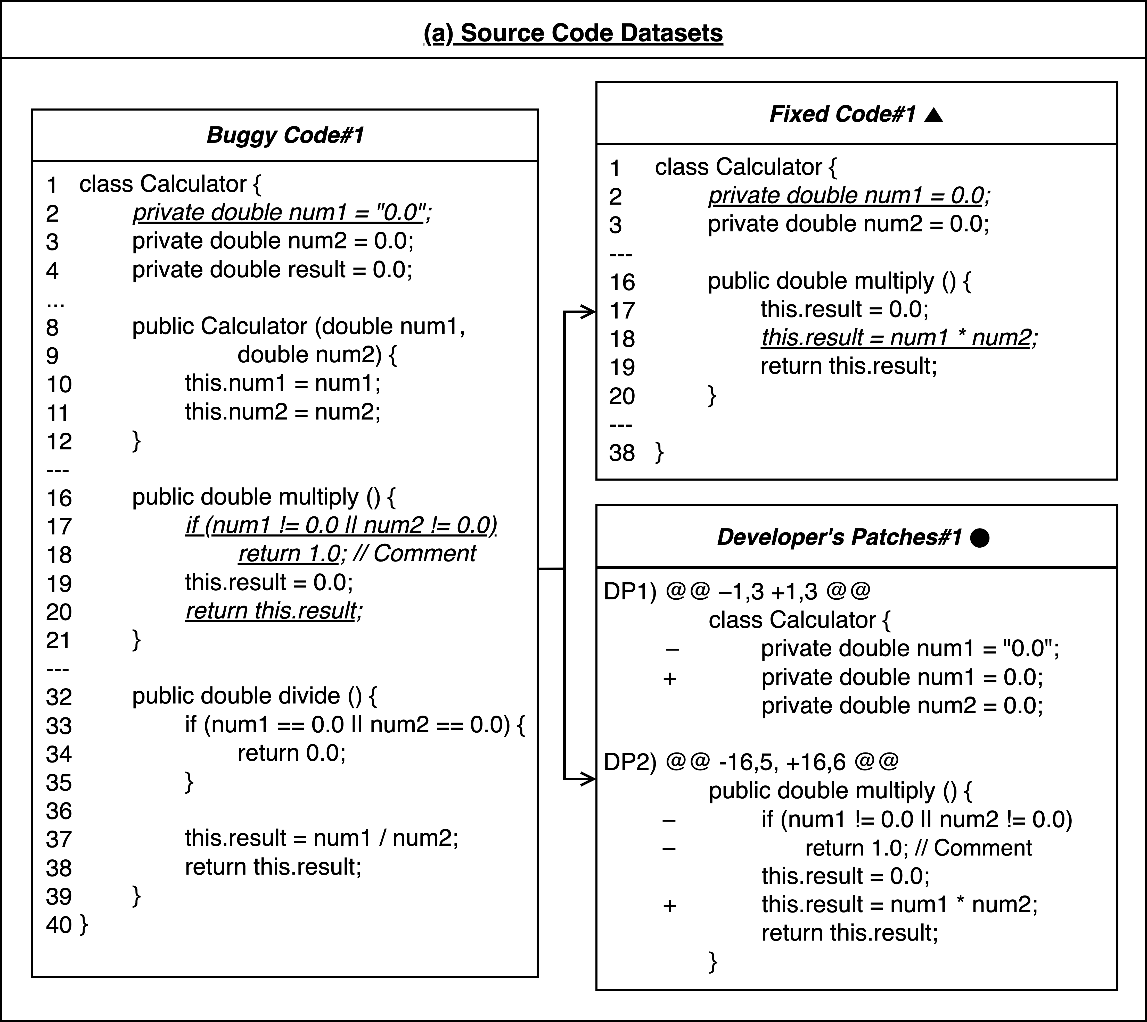
Approach
An example of (a) Source Code Datasets
MCRepair splits the datasets into three sets such as training, validation, and generation.
Buggy Code#1 has the three buggy chunks as in line 2, lines 17–18, and line 20 (Red boxes of Buggy Code#1).
To completely fix the code, it must update line 2, delete lines 17–18, and add a line before line 20. (Blue boxes of Fixed Code#1 or Green boxes of Developer's Patches#1) .
An example of the source code datasets in Fig. 2
(▲: Only use for training or validation, ●: Only use for generation)

Slide 10
Approach
Buggy Block
A method that binds one or more buggy chunks into a “multi-buggy chunk” with method and field dependencies
A multi chunk
bug
A multi-buggy
chunk
Buggy Chunk
Buggy Chunk
with Method Dependency
Buggy Location#1
Buggy Location#2
Buggy Location#1
Buggy Method’s
Top-1 Buggy Context
A method that shares most fields with the buggy method
Buggy
Method
⋯⋯⋯
Buggy Location#2
Buggy Chunk
⋯⋯⋯
Buggy Location#4
Buggy Location#6
⋯⋯⋯
⋯⋯⋯
Buggy Chunk
Buggy Field’s
Top-1 Buggy Context
A method that uses the buggy field based on priority (in the order of constructors, setters, getter, and other methods)
Buggy Location#6
Buggy Chunk
with Field Dependency
Buggy
Field
⋯⋯⋯
Buggy Location#4
Buggy Chunk
Buggy Location#N
Buggy Location#N

Slide 11
Approach
Buggy Block
Constitute each data that includes a buggy chunk in a multi-buggy chunk and its “top-1 buggy context” to achieve better performance
A multi chunk
bug
A multi-buggy
chunk
Buggy Chunk
Buggy Chunk
with Method Dependency
Buggy Location#1
Buggy Location#2
Buggy Location#1
Buggy Method’s
Top-1 Buggy Context
A method that shares most fields with the buggy method
Buggy
Method
⋯⋯⋯
Buggy Location#2
Buggy Chunk
⋯⋯⋯
Buggy Location#4
Buggy Location#6
⋯⋯⋯
⋯⋯⋯
Buggy Chunk
Buggy Field’s
Top-1 Buggy Context
A method that uses the buggy field based on priority (in the order of constructors, setters, getter, and other methods)
Buggy Location#6
Buggy Chunk
with Field Dependency
Buggy
Field
⋯⋯⋯
Buggy Location#4
Buggy Chunk
Buggy Location#N
Buggy Location#N

Slide 12
Approach
CodeBERT [4]
A specific BERT [5] model for source code datasets
Be fine-tuned by buggy blocks and generate a set of candidate patches per buggy block
Its pre-trained processes
Masked Language modeling (MLM)
Replaced token detection (RTD)
Its pre-trained programming languages
C
Java
Python
Javascript
PHP
Go
Its tokenization method
Byte-pair encoding (BPE) => A sub-word tokenization method to prevent OOV

Slide 13
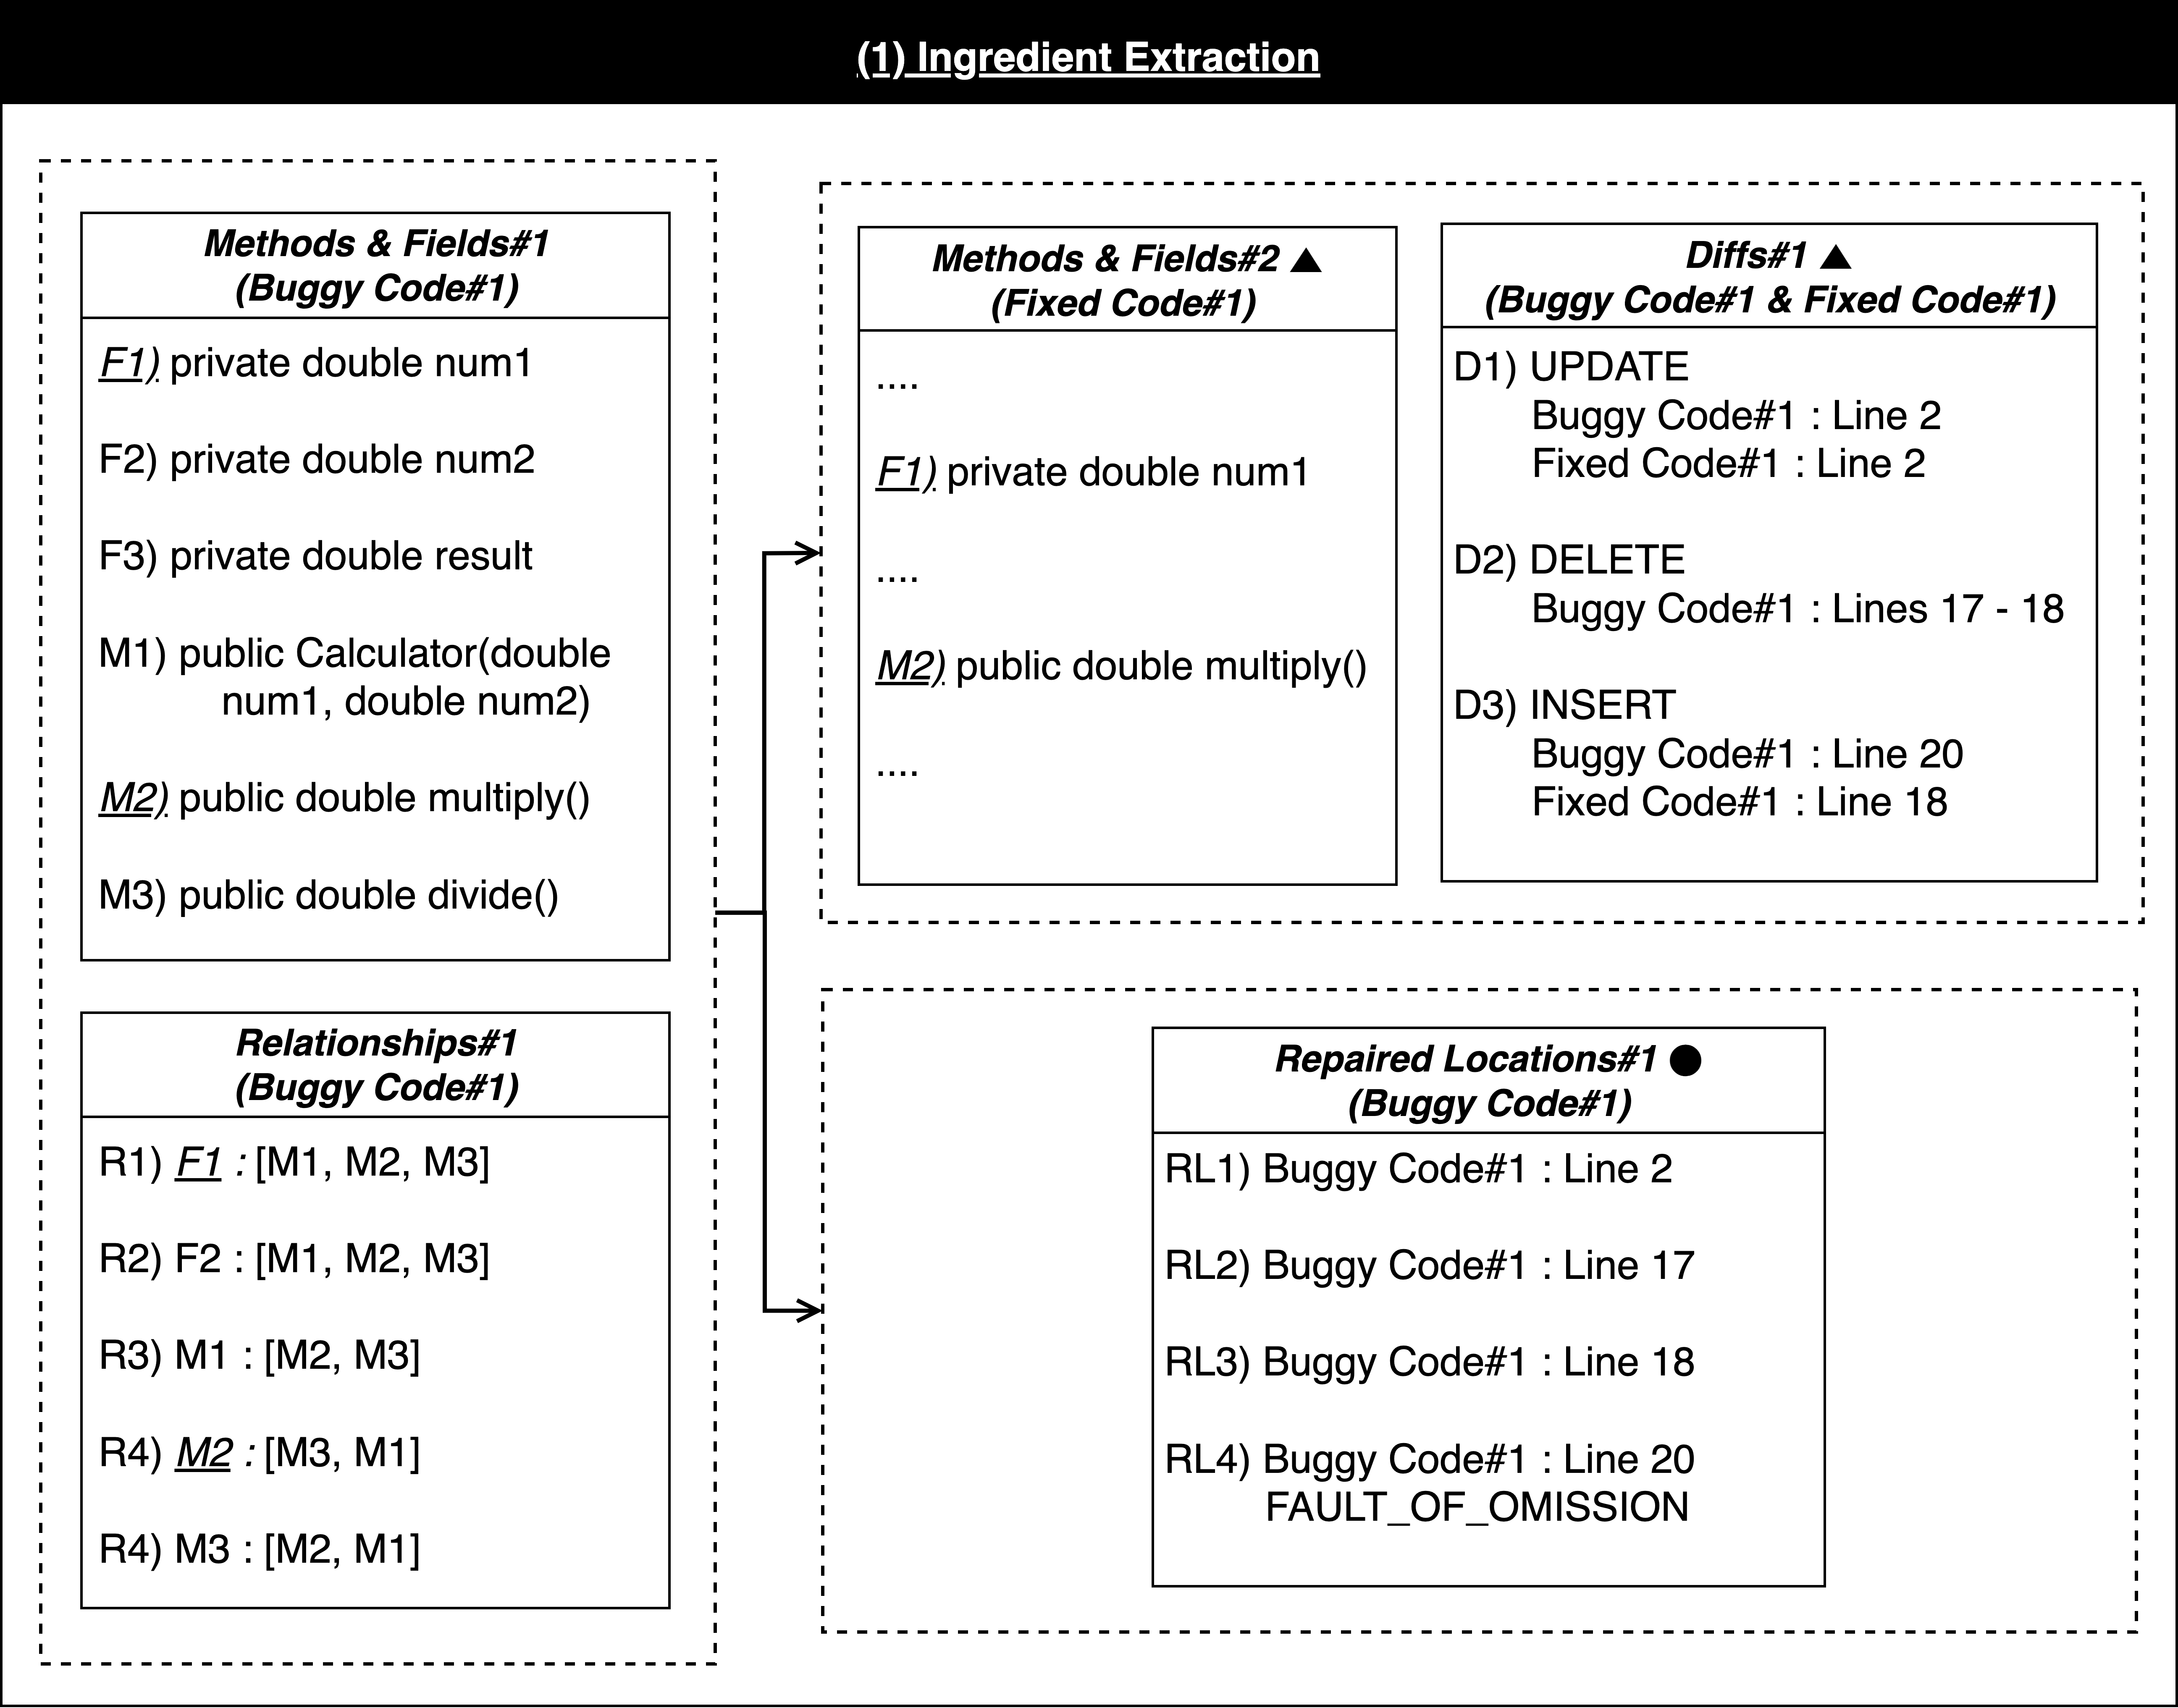
Approach
Process of Buggy Block
Extract buggy chunks (Red boxes), their top-1 buggy contexts (Blue boxes), and their fixed chunks (Green boxes) based on ingredients
Because a fixed chunk indicates a fixed version of a buggy chunk, it is labeled for the buggy chunk.
The ingredients consist of methods, fields, differences, and repaired locations between buggy code and fixed code.
(1) Ingredient Extraction in Fig. 2
(M: Method, F: Field, R: Relationship, D: Difference, RL: Repaired Location)

Slide 14
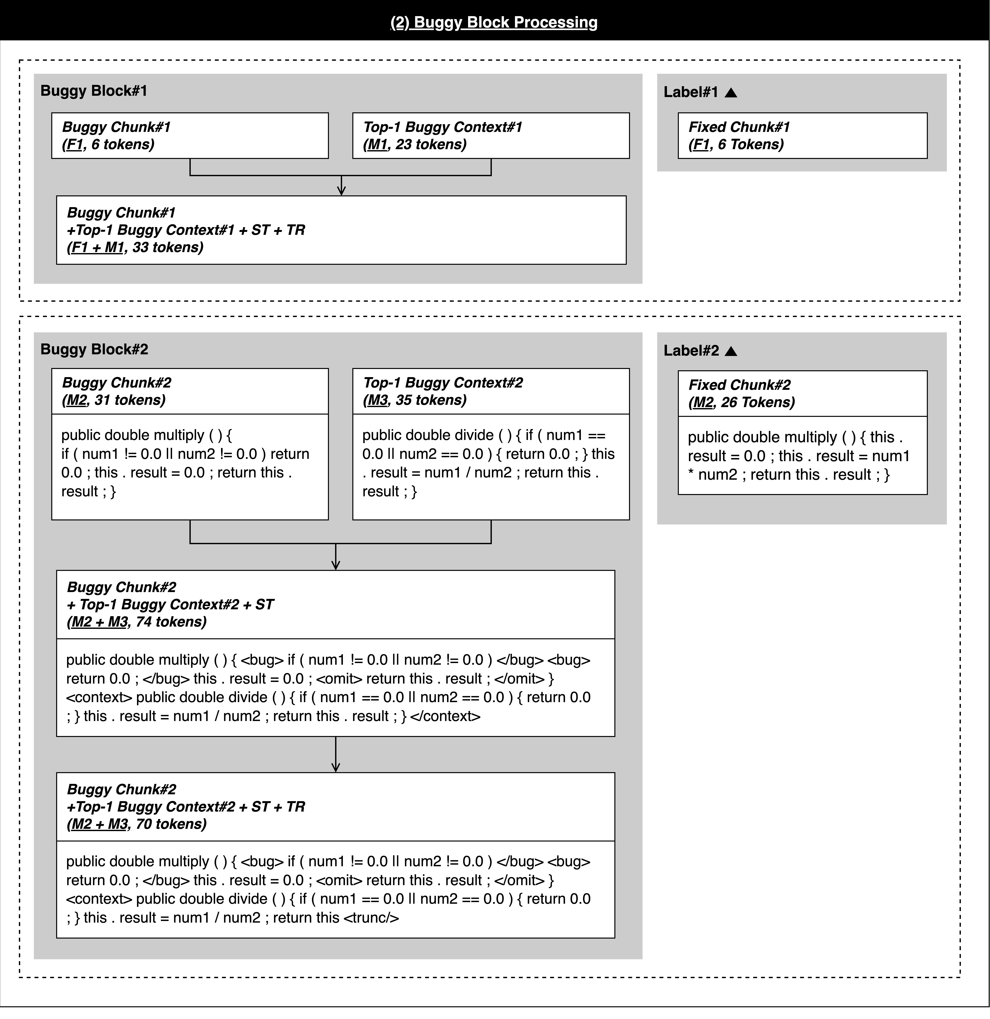
Approach
Process of Buggy Block
Construct the tokens of the buggy chunks and their buggy contexts (Red boxes) into buggy blocks (Blue boxes)
(2) Buggy Block Preprocessing in Fig. 2
(ST: Special Tokens, TR: Truncation)

Slide 15
Approach
Process of Buggy Block
Add special tokens to each block and label for training, validation, and generation (Green boxes)
(2) Buggy Block Preprocessing in Fig. 2
(ST: Special Tokens, TR: Truncation)

Slide 16
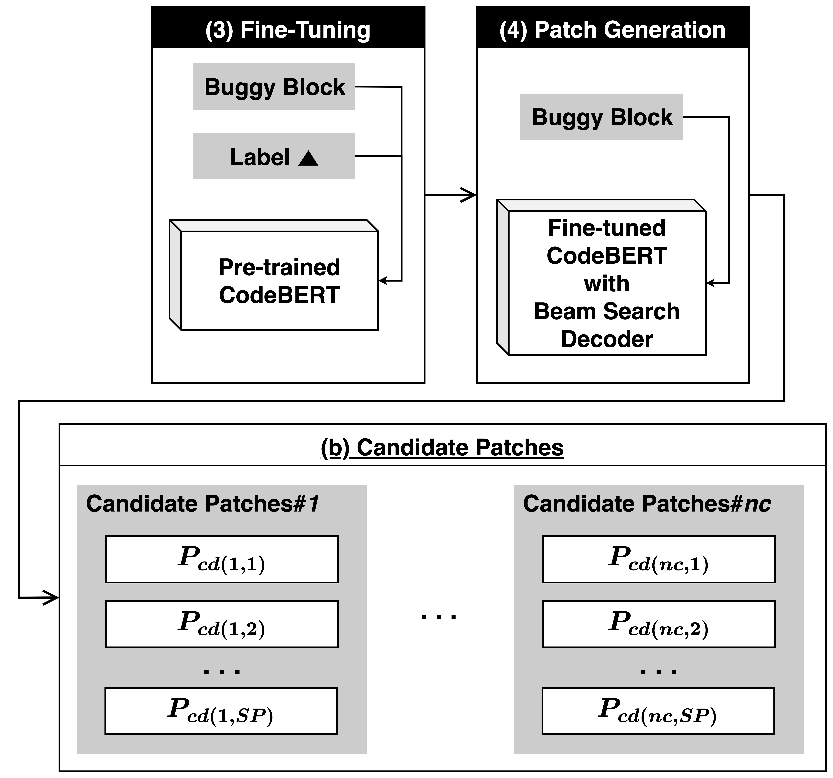
Approach
Process of Buggy Block
Fine-tune a pre-trained CodeBERT by inserting buggy blocks for training or validation with their labels (Red boxes)
Generate candidate patches per buggy block for generation using a fine-tuned CodeBERT and its beam search decoder (Blue boxes)
(3) Fine-Tuning and (4) Patch Generation in Fig. 1
(ST: Special Tokens, TR: Truncation)

Slide 17
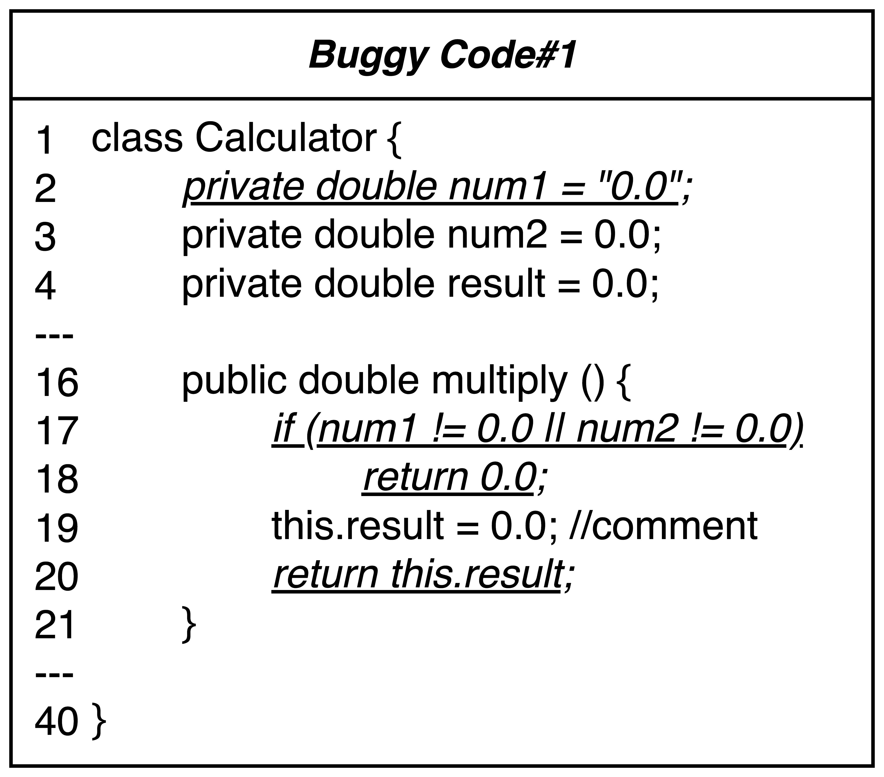
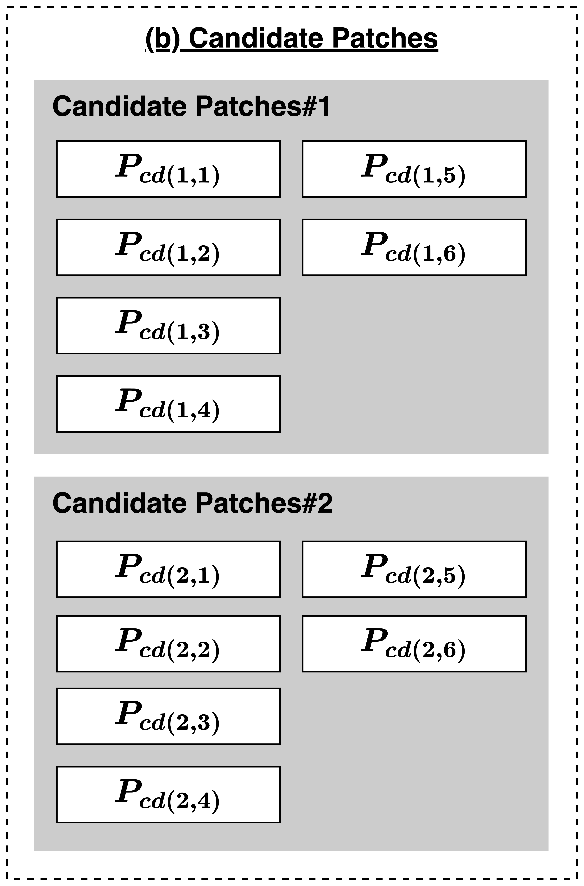
Approach
The buggy block decreases the numbers of buggy chunks and their candidate patches using field and method dependencies.
Buggy Block for the first and second problems
In this slide, we generate 6 candidate patches per buggy chunk.
Original Patch Space for 3 X 6 (18) candidate patches of three buggy chunks
Reduced Patch Space for 2 X 6 (12) candidate patches of two buggy chunks in a multi-buggy chunk with a buggy field and a buggy method
An example of the
candidate patches
in Fig. 3
Buggy Code#1 of Fig. 2
Buggy Code#1 of Fig. 2

Slide 18


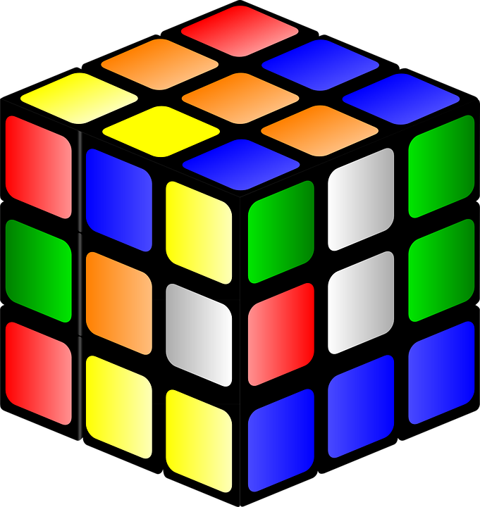
Approach
Patch Optimization
An optimization strategy to effectively combine the generated candidate patches after filtering and ranking
Reduced
Patch Space
More
Reduced
Patch Space
Patch Filtering
Patch Ranking
Patch Combination

Slide 19
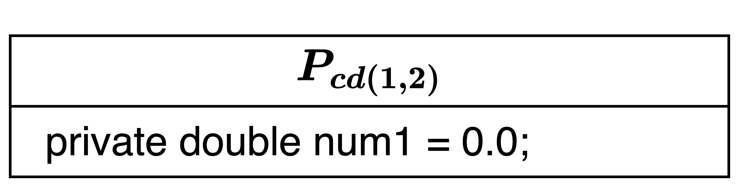
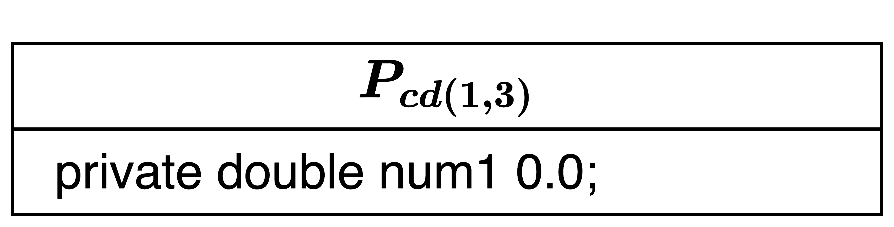
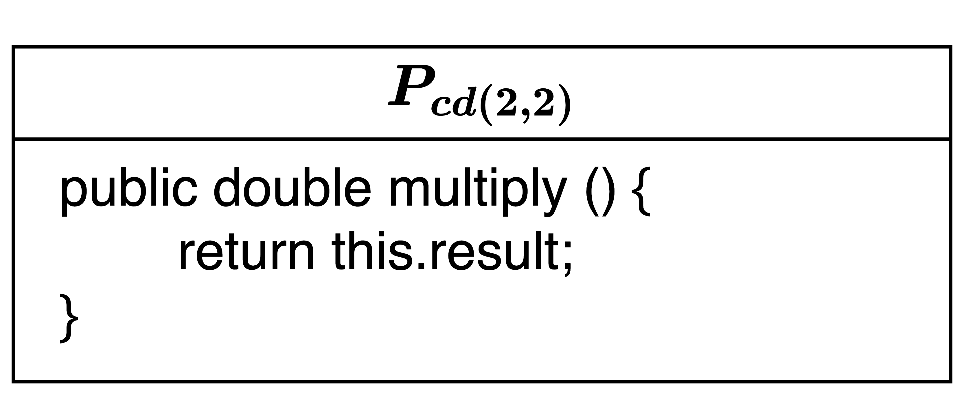
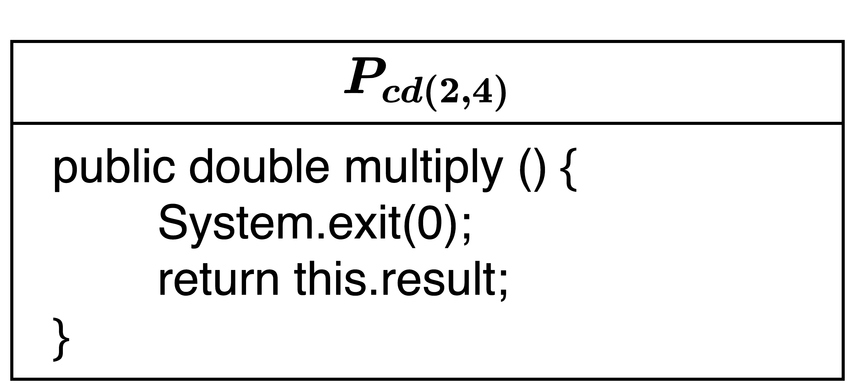
Approach
Process of Patch Optimization
Patch Filtering It removes candidate patches that are duplicated, have syntax errors, or include termination code (e.g., System.exit) to minimize the number of candidate patches per buggy block.
Because the patches that include the termination code cannot evaluate, they are filtered out.
Filtered Candidate Patches of Fig. 3 (DP: Duplicated, SE: Syntax Error, TC: Termination Code)
Filtered Candidate Patches of Fig. 3

Slide 20
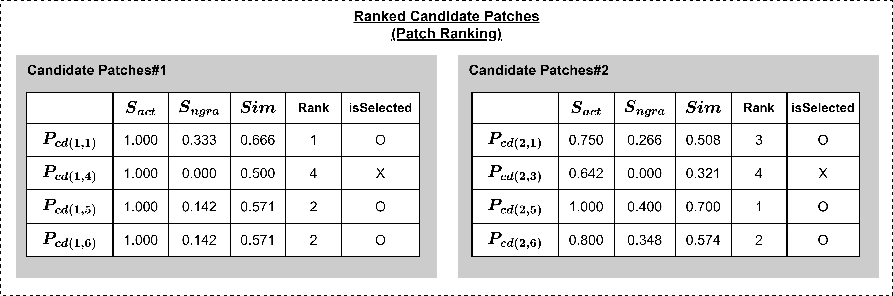
Approach
Process of Patch Optimization
Patch Ranking It ranks candidate patches using Equation 1.
According to Reference number [6], a correct patch has a small-edit size compared to its buggy code because the patch minimally changes the buggy code.
A weighted sum of the two ranking measures
$$Sim\left(P_{cd\left(i,j\right)}\right)=\left(α×S_{act}\left(P_{cd\left(i,j\right)}\right)\right)+\left(β×S_{ngra}\left(P_{cd\left(i,j\right)}\right)\right)$$
Action similarity
N-gram similarity
Ranked Candidate Patches of Fig. 3

Slide 21

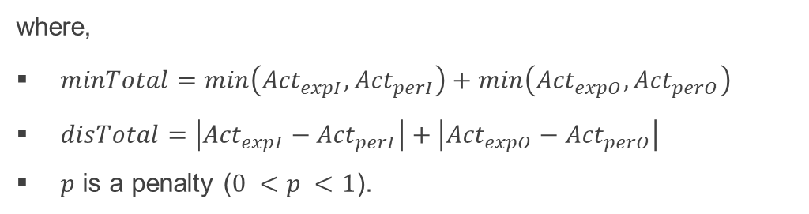
Approach
Process of Patch Optimization
Patch Ranking – Action similarity
Action similarity considers the expected actions between a buggy code and its candidate patch at “Repaired Locations” using Equation 2.
Obatined miniumum
Penalized distance
$$S_{act}=\frac{minTotal+p×disTotal}{minTotal+disTotal}$$
The expected insertions that a location indicates “FAULT_OF_OMISSION”
where,
$minTotal=\min\left({Act}_{expI},{Act}_{perI}\right)+\min\left({Act}_{expO},{Act}_{perO}\right)$
$disTotal=\left|{Act}_{expI}−{Act}_{perI}\right|+\left|{Act}_{expO}−{Act}_{perO}\right|$
$p$ is a penalty ($0 <p <1$).
The expected other actions including updates and deletions

Slide 22
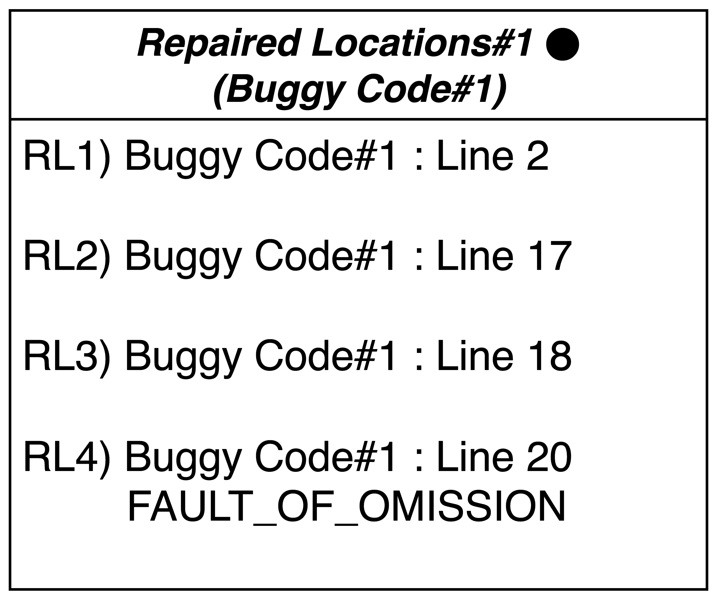
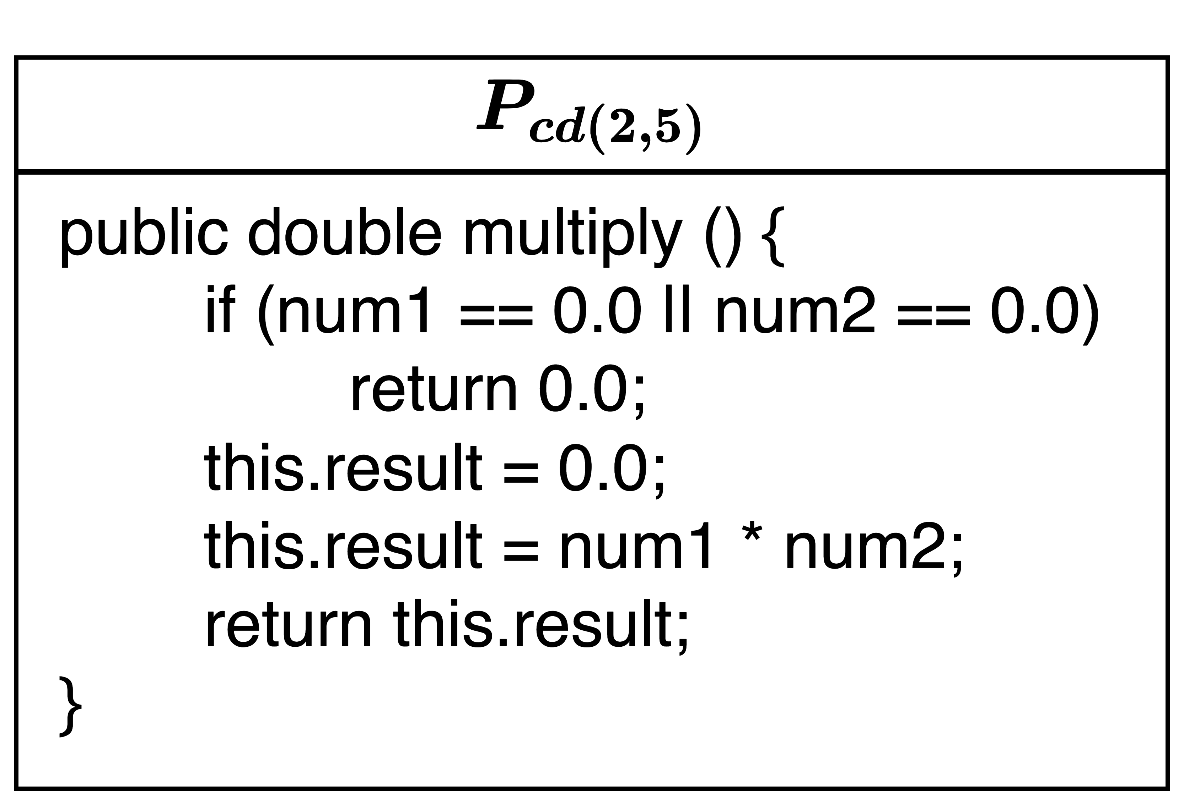
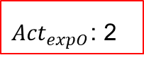



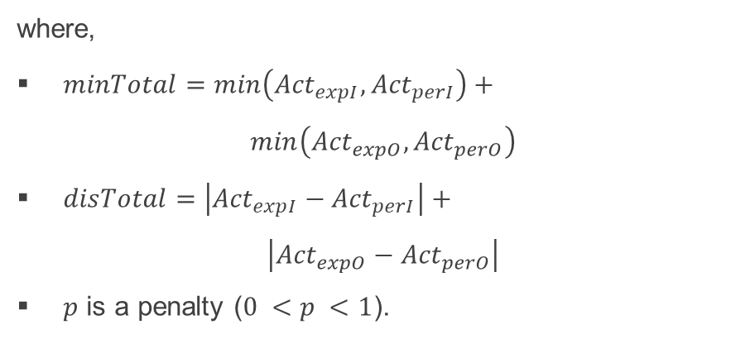

Approach
Process of (5) Patch Optimization
Patch Ranking – Action similarity’s example
1 + 2 = 3
0.5
0 + 0 = 0
$$S_{act}=\frac{minTotal+p×disTotal}{minTotal+disTotal}$$
1.000
1 + 2
0 + 0
where,
$minTotal=\min\left({Act}_{expI},{Act}_{perI}\right)+$ $\min\left({Act}_{expO},{Act}_{perO}\right)$
$disTotal=\left|{Act}_{expI}−{Act}_{perI}\right|+$ $\left|{Act}_{expO}−{Act}_{perO}\right|$
$p$ is a penalty ($0 <p <1$).
${Act}_{expI}$: 1
${Act}_{perI}$: 1
${Act}_{expO}$: 2
${Act}_{perO}$: 2
Repaired Location#1
of Fig. 2
A candidate patch of Fig. 3

Slide 23
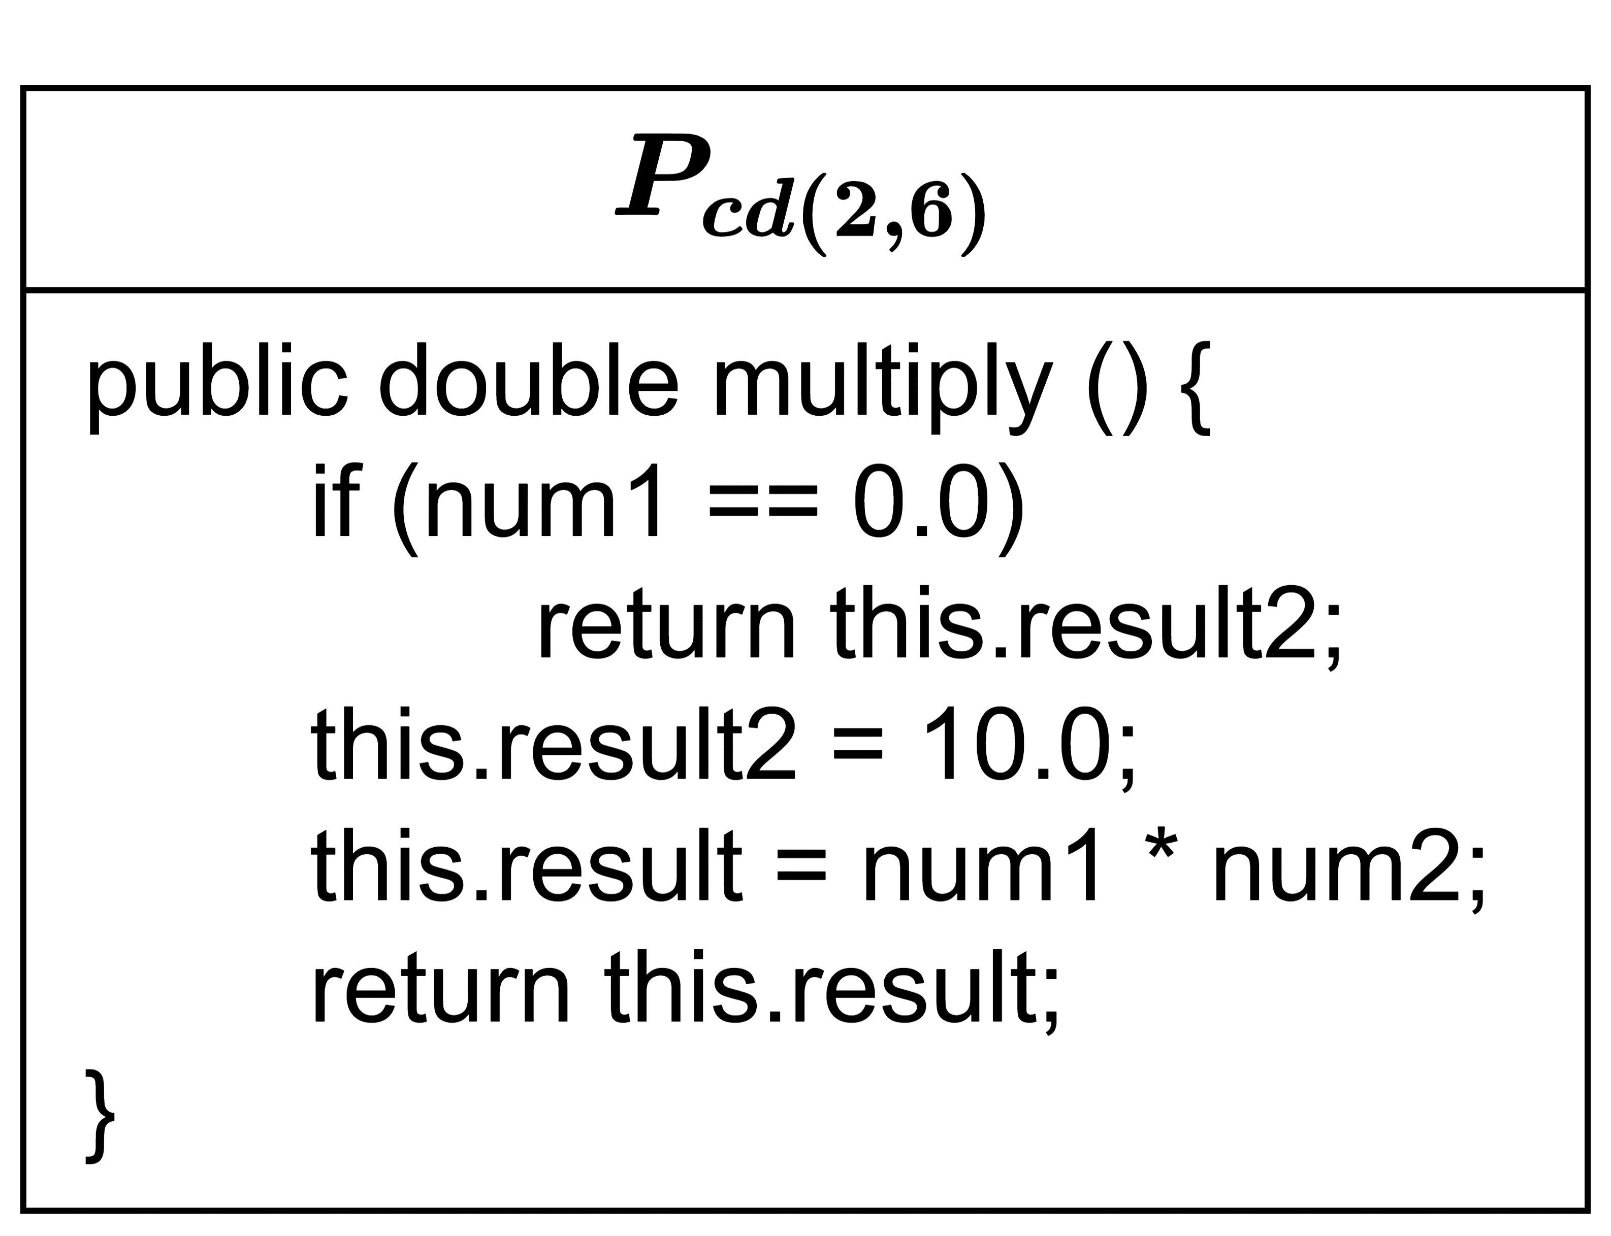
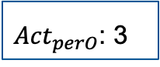
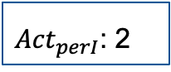
Approach
Process of (5) Patch Optimization
Patch Ranking – Action similarity’s example
1 + 2 = 3
0.5
1 + 1 = 2
$$S_{act}=\frac{minTotal+p×disTotal}{minTotal+disTotal}$$
0.800
1 + 2 = 3
1 + 1 = 2
where,
$minTotal=\min\left({Act}_{expI},{Act}_{perI}\right)+$ $\min\left({Act}_{expO},{Act}_{perO}\right)$
$disTotal=\left|{Act}_{expI}−{Act}_{perI}\right|+$ $\left|{Act}_{expO}−{Act}_{perO}\right|$
$p$ is a penalty ($0 <p <1$).
${Act}_{expI}$: 1
${Act}_{perI}$: 2
${Act}_{expO}$: 2
${Act}_{perO}$: 3
Repaired Location#1
of Fig. 2
A candidate patch of Fig. 3

Slide 24
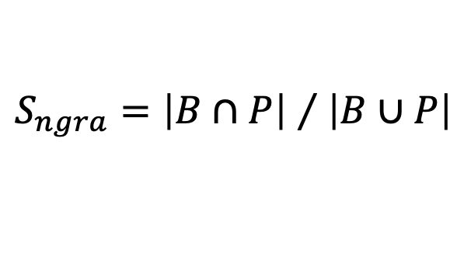
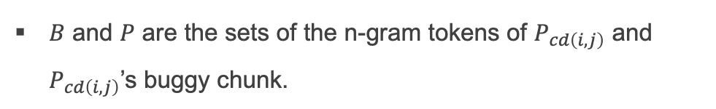
Approach
Process of Patch Optimization
Patch Ranking – N-gram similarity
N-gram similarity considers the structure and syntax changes between a buggy code and its candidate patch using Equation 3.
$$S_{ngra}={\left|B∩P\right| }/{ \left|B∪P\right|}$$
Jaccard Similarity
$B$ and $P$ are the sets of the n-gram tokens of $P_{cd\left(i,j\right)}$ and $P_{cd\left(i,j\right)}$’s buggy chunk.

Slide 25
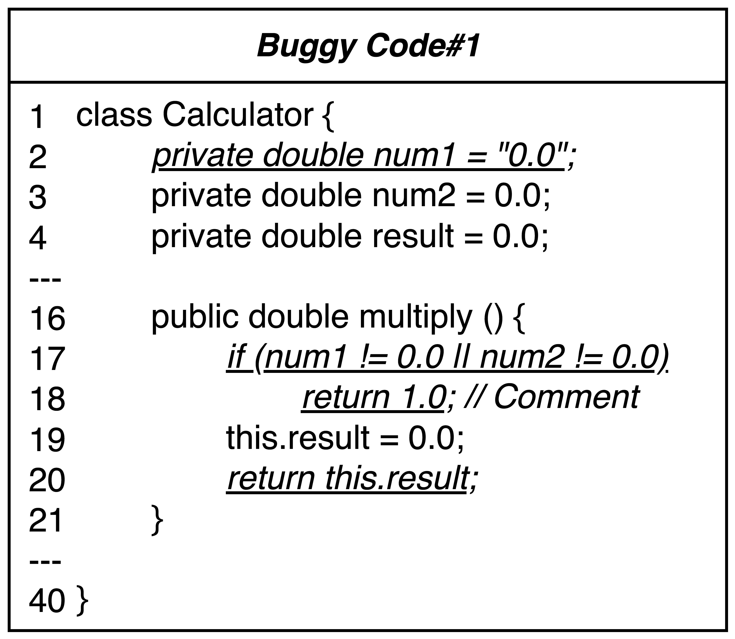
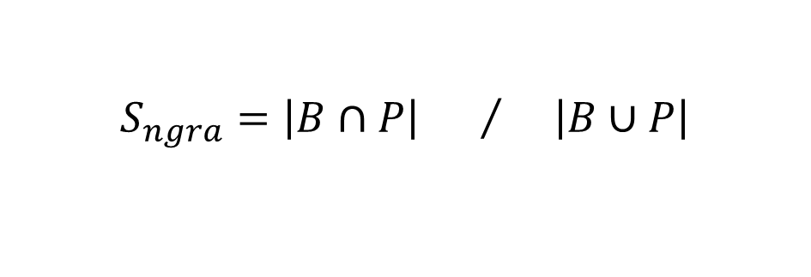
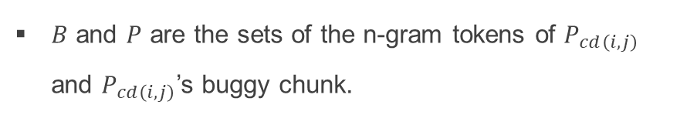
Approach
Process of Patch Optimization
Patch Ranking – N-gram similarity’s example
15
42
$$S_{ngra}={\left|B∩P\right| }/{ \left|B∪P\right|}$$
0.357
The intersection size of
the n-gram sets
The union size of
the n-gram sets
$B$ and $P$ are the sets of the n-gram tokens of $P_{cd\left(i,j\right)}$ and $P_{cd\left(i,j\right)}$’s buggy chunk.
Repaired Location#1
of Fig. 2
A candidate patch of Fig. 3

Slide 26
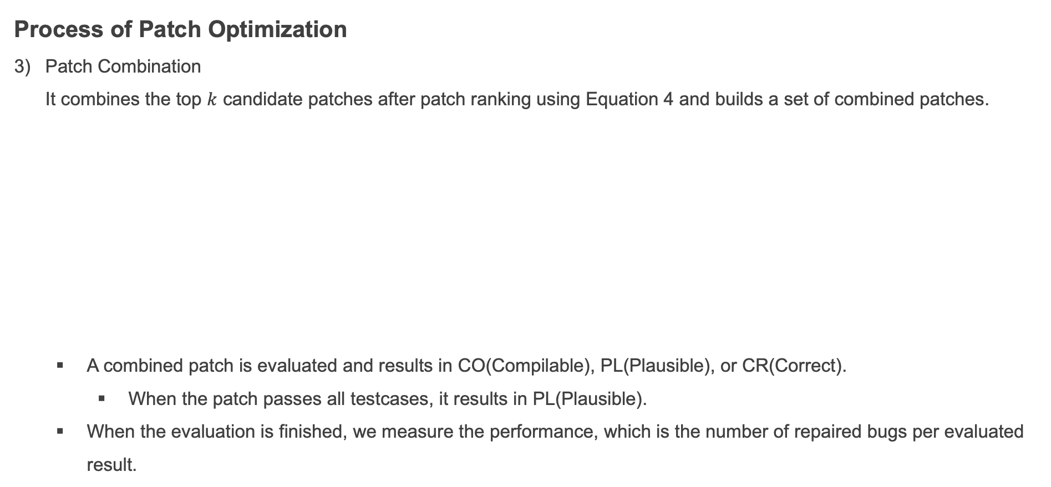
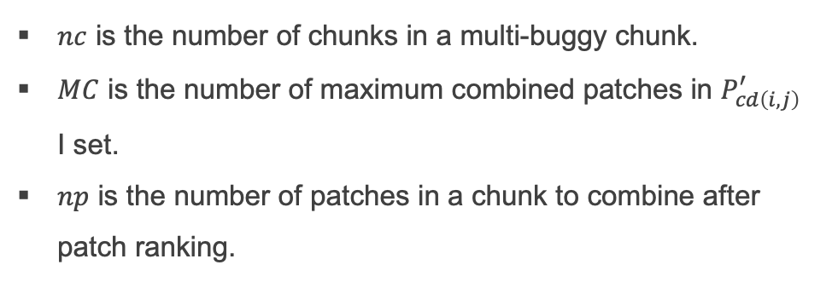
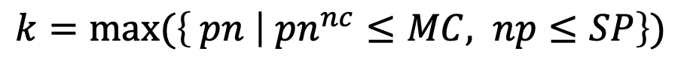
Approach
Process of Patch Optimization
Patch Combination It combines the top $k$ candidate patches after patch ranking using Equation 4 and builds a set of combined patches.
A combined patch is evaluated and results in CO(Compilable), PL(Plausible), or CR(Correct).
When the patch passes all testcases, it results in PL(Plausible).
When the evaluation is finished, we measure the performance, which is the number of repaired bugs per evaluated result.
$$k=max⁡(\left\{ pn | {pn}^{nc}≤MC, np≤SP\right\})$$
$nc$ is the number of chunks in a multi-buggy chunk.
$MC$ is the number of maximum combined patches in $P_{cd\left(i,j\right)}^{′}$ I set.
$np$ is the number of patches in a chunk to combine after patch ranking.

Slide 27
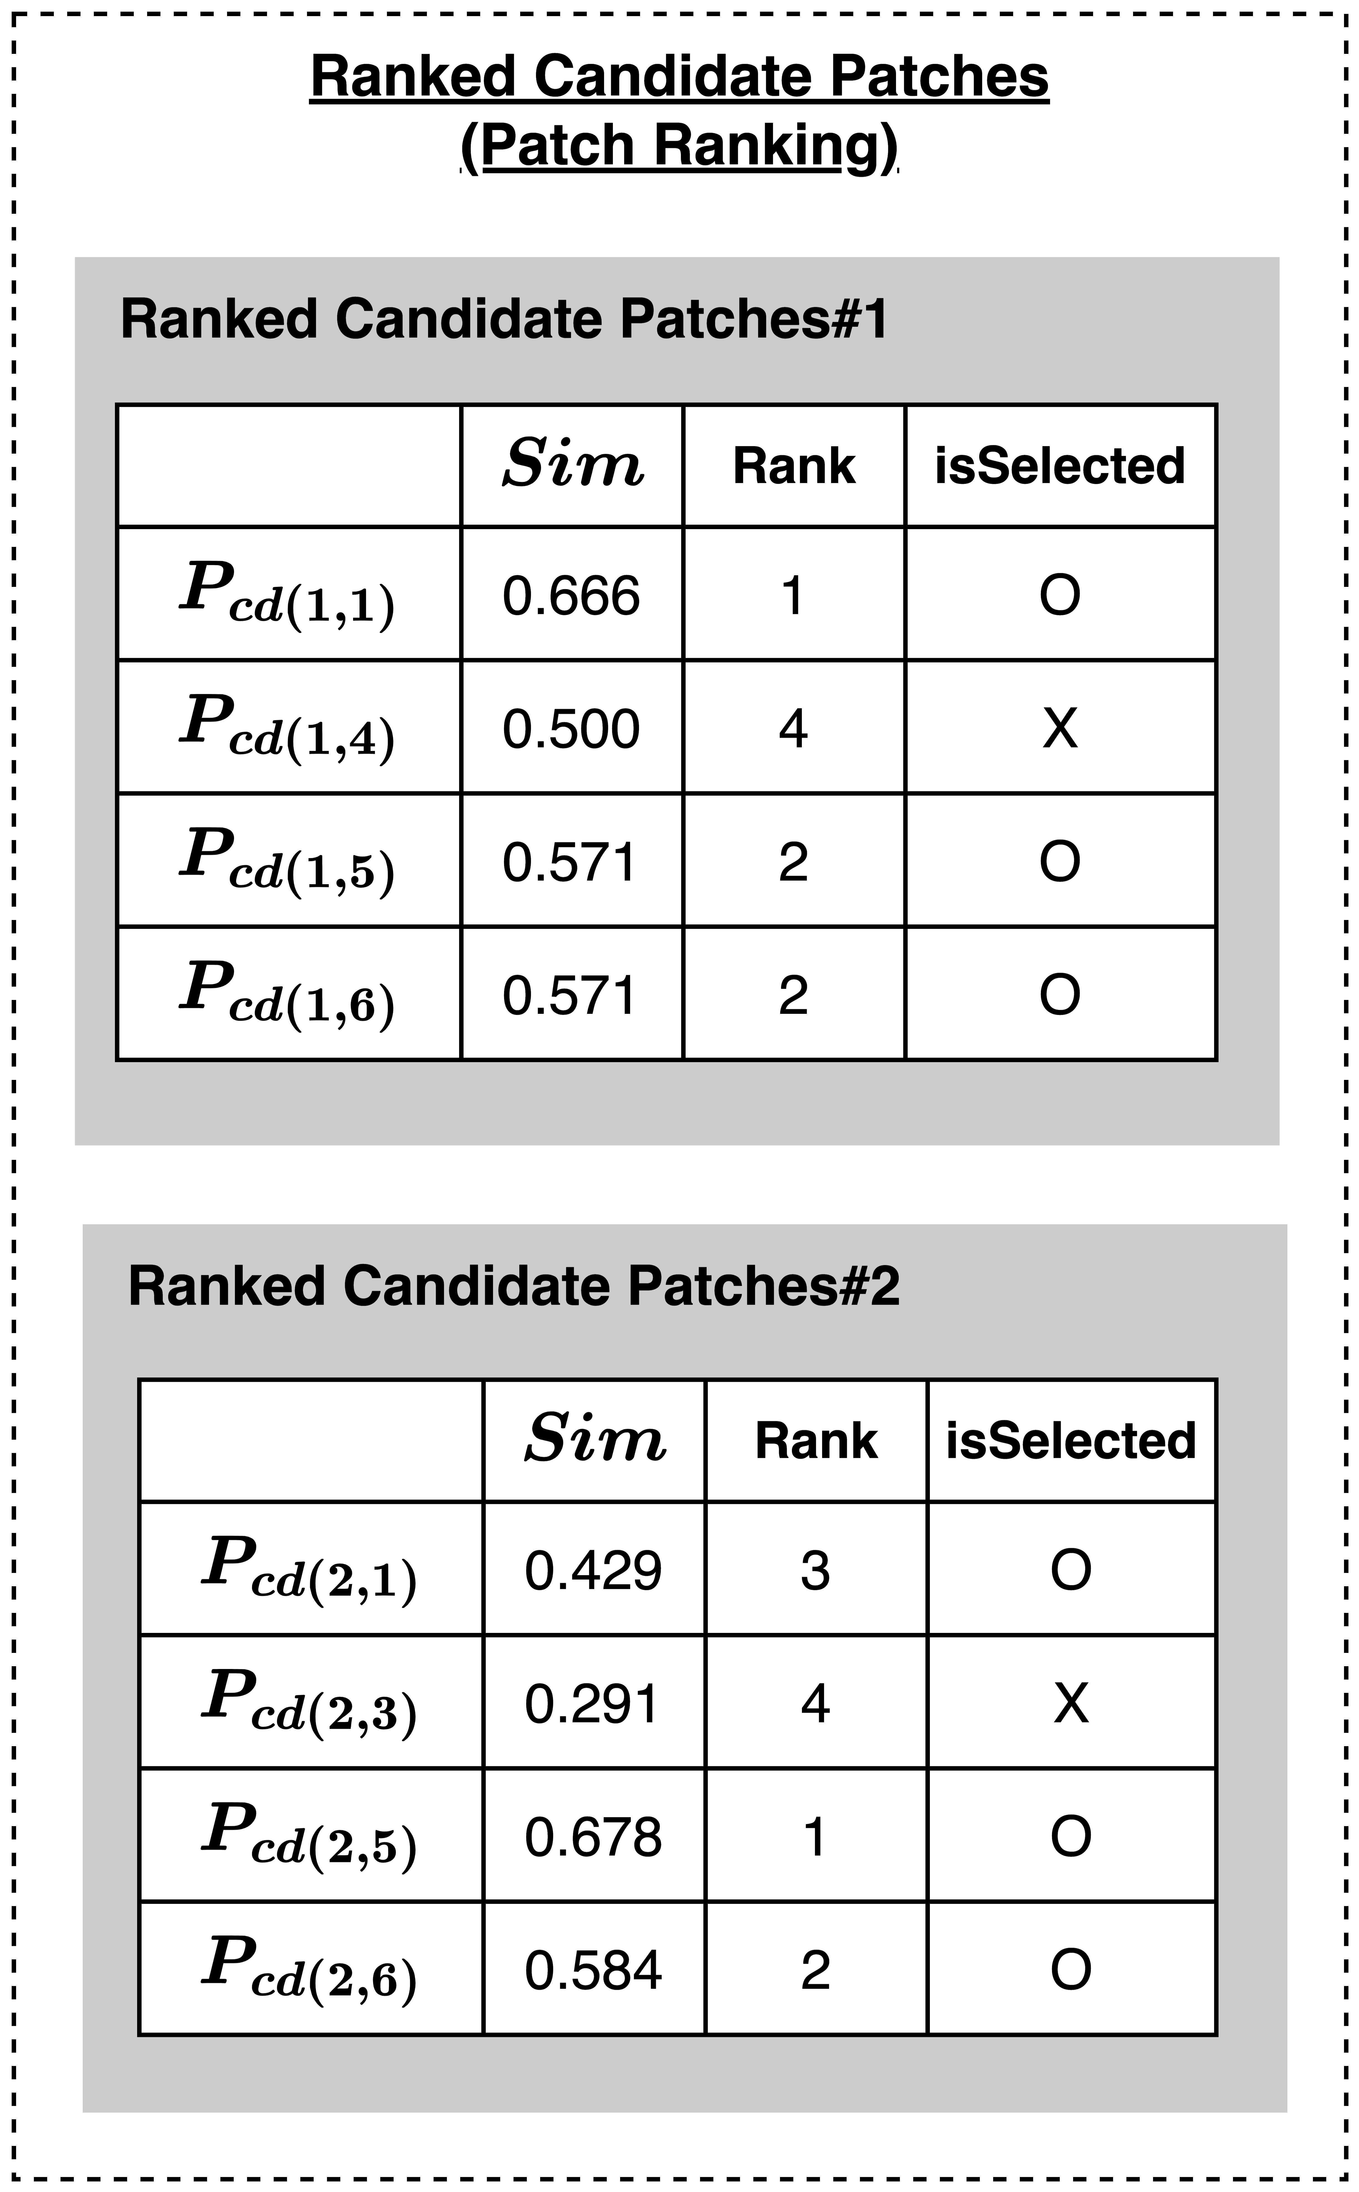
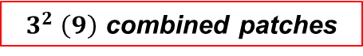
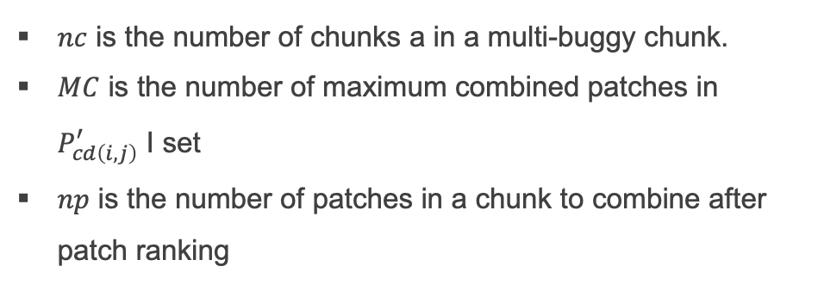
Approach
Process of Patch Optimization
Patch Combination – The combination’s example
2
10
6
$$k=max⁡(\left\{ pn | {pn}^{nc}≤MC, np≤SP\right\})$$
3
{1, 2, 3}
$nc$ is the number of chunks a in a multi-buggy chunk.
$MC$ is the number of maximum combined patches in $P_{cd\left(i,j\right)}^{′}$ I set
$np$ is the number of patches in a chunk to combine after patch ranking
$3^{2} \left(9\right)$ combined patches
Ranked Candidate Patches of Fig. 3
Combined Patches of Fig. 3

Slide 28
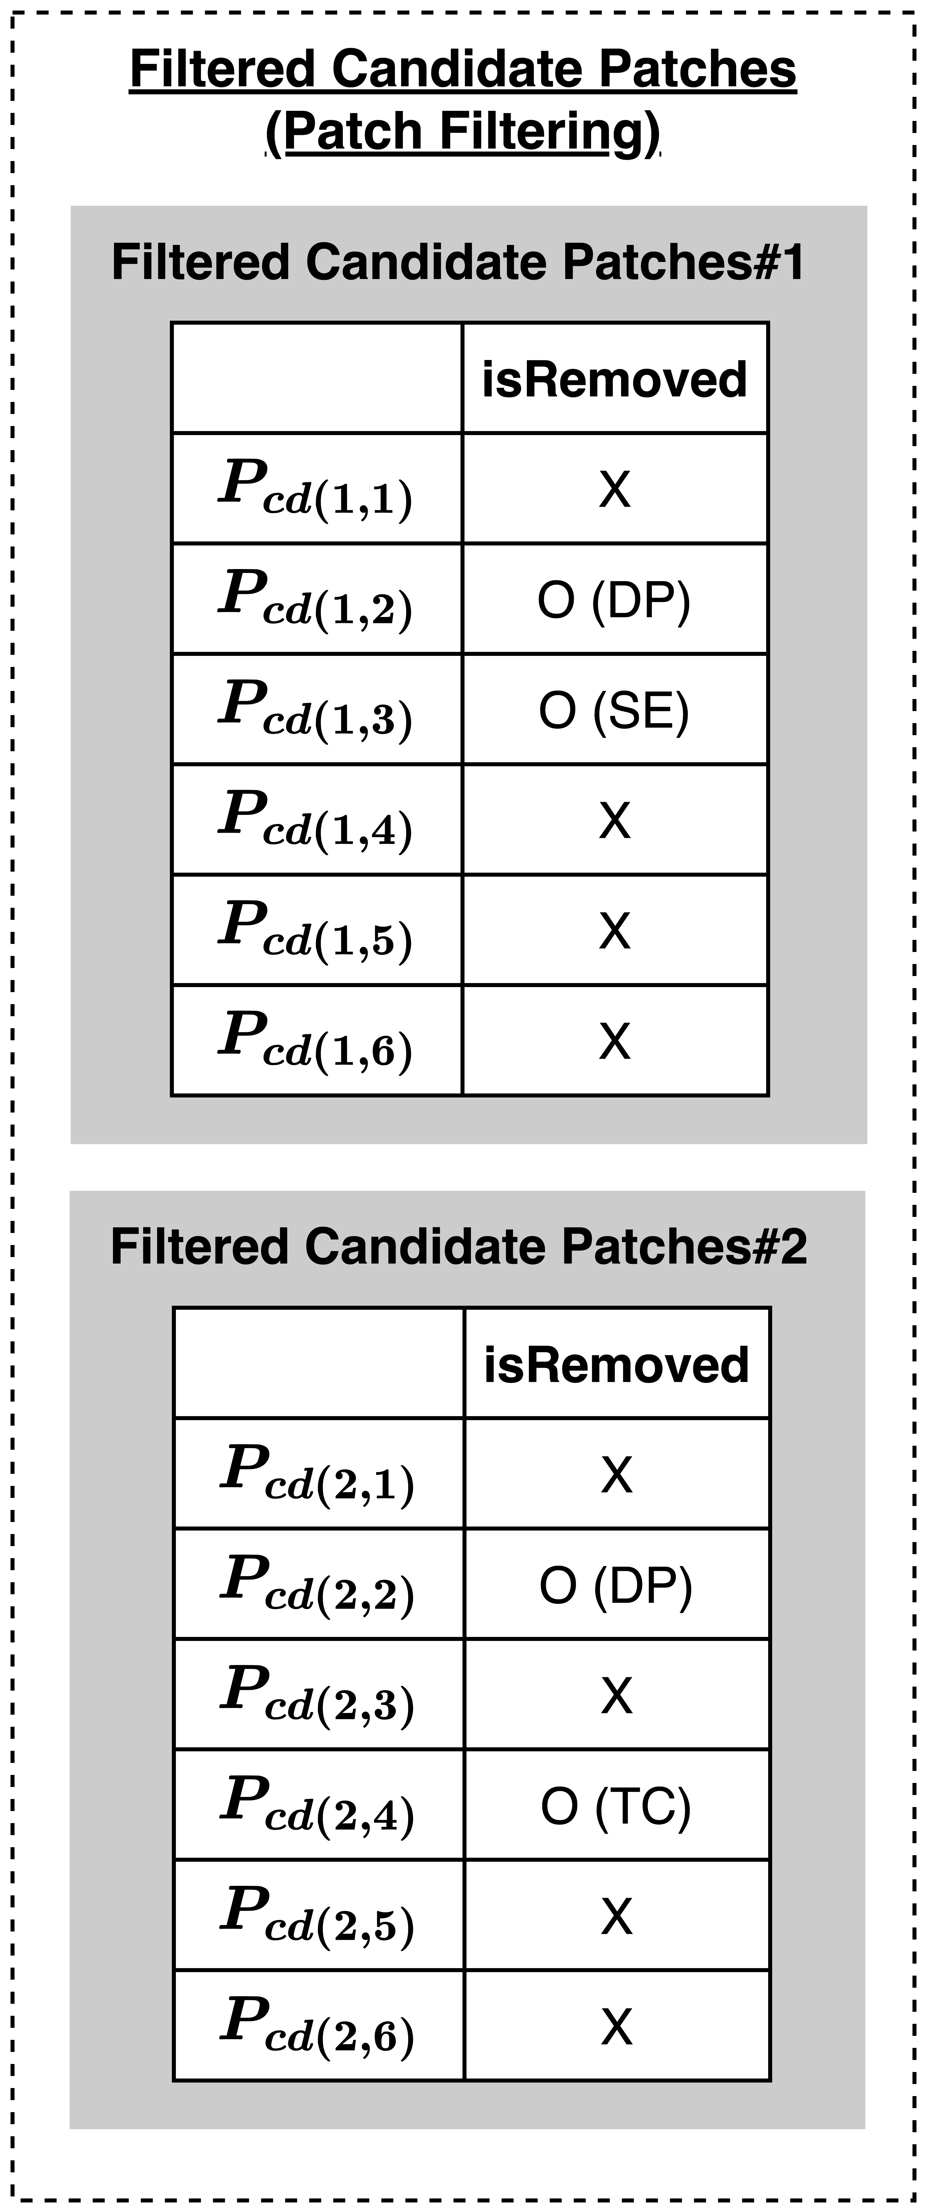

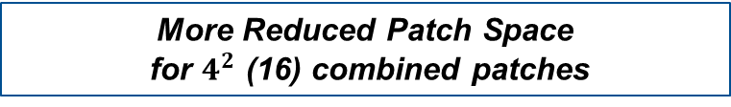
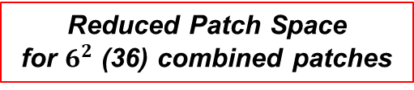
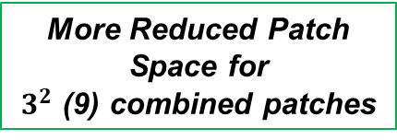
Approach
Patch Optimization for the third problem
The patch optimization decreases the numbers of the generated candidate patches and their combined patches.
Reduced Patch Space
for $6^{2}$ (36) combined patches
More Reduced Patch Space
for $4^{2}$ (16) combined patches
More Reduced Patch Space for
$3^{2}$ (9) combined patches

Slide 29

Approach
Buggy Block and Patch Optimization with Patch Space
The proposed buggy block and patch optimization reduce the patch space for multi-chunk bugs because it decreases the numbers of buggy chunks, candidate patches, and combined patches using method and filed dependencies.
Patch Space for 6 X 6 X 6 (108) combined patches by three buggy chunks
Reduced Patch Space for 6 X 6 (36)
combined patches by two buggy chunks in a multi-buggy chunk
More Reduced Patch Space for 3 X 3 (9) combined patches

Slide 30
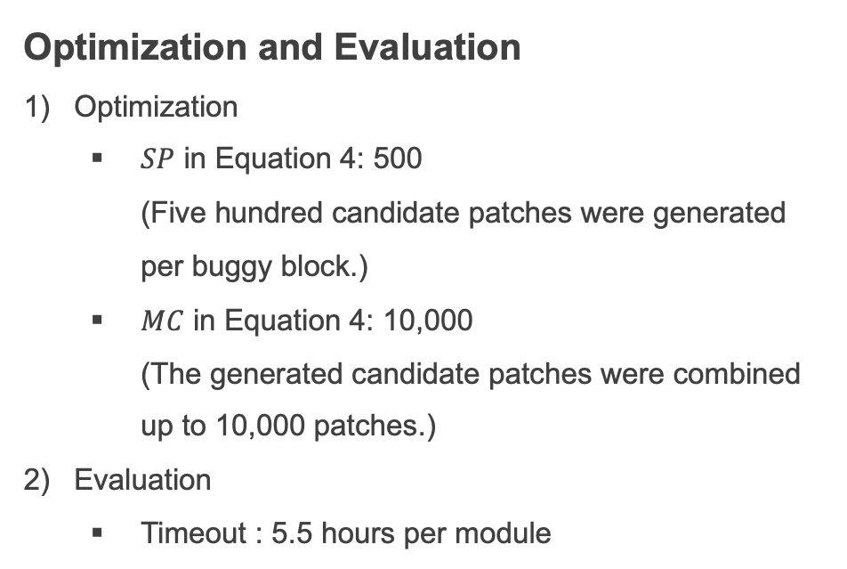
Experimental Setup
Datasets and Fine-tuning
Datasets
Training and validation dataset: Bugs2Fix [7]
Generation (benchmark) dataset: Defects4J [8]
Fine-tuning
max_token_length=512
batch_size=16
dropout_rate= 0.1
Optimization and Evaluation
Optimization
$SP$ in Equation 4: 500 (Five hundred candidate patches were generated per buggy block.)
$MC$ in Equation 4: 10,000 (The generated candidate patches were combined up to 10,000 patches.)
Evaluation
Timeout : 5.5 hours per module

Slide 31
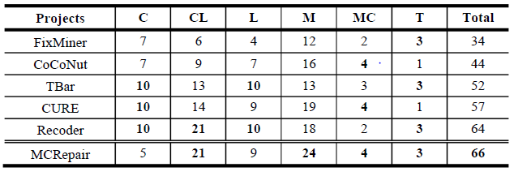
Experimental Results
RQ1. Performance of MCRepair
The results of RQ1 were the number of correctly fixed bugs.
Perfect fault localization assumes known buggy locations without fault localization execution excluding its bias problem.
Table 1: RQ1. Comparison with Learning-based and Template-based APR techniques on Defects4J with Perfect Fault Localization.
(C: Chart, CL: Closure, L: Lang, M: Math,
MC: Mockito, T: Time)
The highest number of each column is in bold.
Fixed at least two and up to 32 more bugs than the baselines
+ 32
+ 22
+ 12
+ 9
+ 2

Slide 32
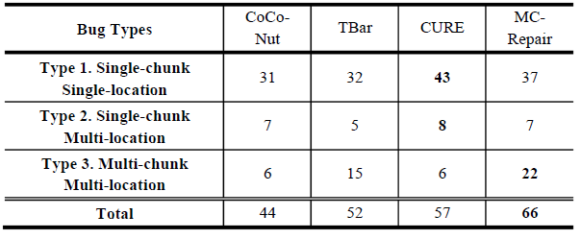
Experimental Results
RQ1. Performance of MCRepair
The results of RQ1 were the number of correctly fixed bugs.
Table 2: RQ1. Comparison with the state-of-the-art APR techniques on Defects4J with Perfect Fault Localization.
(In terms of multi-chunk bugs)
Table 2: RQ1. Comparison with the state-of-the-art APR techniques on Defects4J with Perfect Fault Localization.
(In terms of total bugs)
46–266% relative imporvements
+ 16
+ 7
+ 16
15–50% relative imporvements
+ 22
+ 14
+ 9
266% ↑
46% ↑
266% ↑
50% ↑
26% ↑
15% ↑

Slide 33
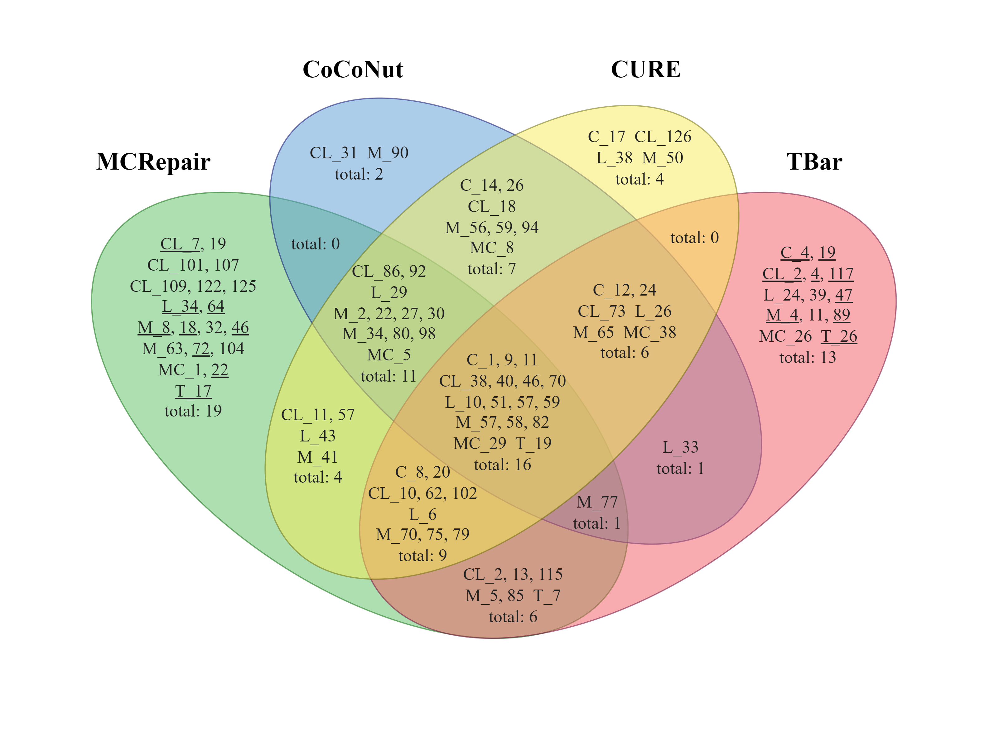
Experimental Results
RQ1. Performance of MCRepair
The results of RQ1 were the number of correctly fixed bugs.
Found 19 unique bugs including nine multi-chunk bugs
Outperformed the baselines and Found a number of unique bugs
Figure 4: RQ1. Venn Diagram about Table 2.
(Underlined: Unique Type 3 bugs)

Slide 34
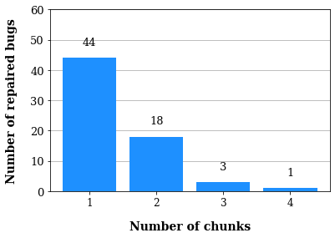
Experimental Results
RQ2. Generalizability of MCRepair
The results of RQ2 were the same as them of RQ1.
Generalized at least one and up to four chunks
Figure 5: RQ2. Statistics per chunk range on Defects4J with Perfect Fault Localization.

Slide 35
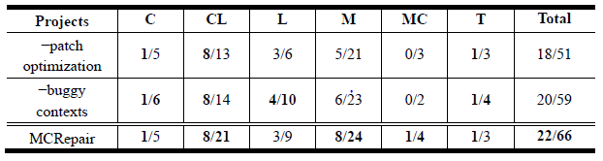
Experimental Results
RQ3. Contribution of MCRepair’s each component
The results of RQ3 were also the same as them of RQ1.
Removed two components such as patch optimization and buggy contexts in buggy blocks
Table 3: RQ3. Sensitivity Analysis for MCRepair on Defects4J with Perfect Fault Localization.
The results are displayed as x/y.
x and y are the number of correctly repaired Type 3 bugs and total bugs.
(w/o: without)
The removal rates decreased by 15 and 7 bugs.
Fixed four Type 3 fewer bugs without patch optimization
The components affected the performance
including multi-chunk bugs.
▽ 4 / ▽ 15
▽ 2 / ▽ 7

Slide 36
Conclusion
We proposed an APR technique named “MCRepair” that utilized a buggy block, patch optimization, and CodeBERT to target multi-chunk bugs.
It addressed the three complex problems such as large patch space, dependencies of buggy chunks, and patch combination.
On Defects4J, MCRepair correctly repaired 66 bugs, including 22 multi-chunk bugs.
We improved 46–266% performance than the baselines in terms of multi-chunk bugs.
We found 19 unique bugs, including nine multi-chunk bugs.
In future work, we will improve MCRepair with its findings and limitations.

Slide 37
Conclusion
The results of MCRepair were opened in the following URL.
https://github.com/kimjisung78/MCRepair

Slide 38
References in our paper
[4] Z. Feng et al. 2020. CodeBERT: A Pre-Trained Model for Programming and Natural Languages. In Findings of the Association for Computational
Linguistics: EMNLP 2020. Association for Computational Linguistics, Stroudsburg, PA, USA, 1536–1547. DOI: https://doi.org/10.18653/v1/2020.findings-emnlp.139
[5] J. Devlin, M.W. Chang, K. Lee, and K. Toutanova. 2019. BERT: Pre-training of Deep Bidirectional Transformers for Language Understanding. In
Proceedings of the 2019 Conference of the North American Chapter of the Association for Computational Linguistics: Human Language
Technologies (NAACL), Association for Computational Linguistics, Stroudsburg, PA, USA, 4171–4186. DOI:https://doi.org/10.18653/v1/N19-1423
[6] S. Wang et al. 2020. Automated patch correctness assessment: how far are we? In Proceedings of the IEEE/ACM 35th International Conference on
Automated Software Engineering (ASE), ACM, New York, NY, USA, 968–980. DOI:https://doi.org/10.1145/3324884.3416590
[7] M. Tufano et al. 2018. An empirical investigation into learning bug-fixing patches in the wild via neural machine translation. In Proceedings of the
33rd ACM/IEEE International Conference on Automated Software Engineering (ASE), ACM, New York, NY, USA, 832–837.
DOI:https://doi.org/10.1145/3238147.3240732
[8] R. Just, D. Jalali, and M.D. Ernst. 2014. Defects4J: a database of existing faults to enable controlled testing studies for Java programs. In
Proceedings of the 2014 ACM International Symposium on Software Testing and Analysis (ISSTA), ACM Press, New York, New York, USA, 437–440.
[15] P. Adam et al. 2019. PyTorch: An Imperative Style, High-Performance Deep Learning Library. In Advances in Neural Information Processing Systems
32 (NeurIPS 2019). [16] T. Wolf et al. 2020. Transformers: State-of-the-Art Natural Language Processing. In Proceedings of the 2020 Conference on Empirical Methods in
Natural Language Processing (EMNLP): System Demonstrations, Association for Computational Linguistics, Stroudsburg, PA, USA, 38–45.
DOI:https://doi.org/10.18653/v1/2020.emnlp-demos.6

Slide 39
Thank you!
Jisung Kim and Byeongjung Lee
{kimjisung78, bjlee}@uos.ac.kr

Slide 40
Q & A

Slide 41
Thank you so much!
Jisung Kim and Byeongjung Lee*
{kimjisung78, bjlee}@uos.ac.kr

